Slide 1


ARCHIVAL AND RETRIEVAL OF MISSING OBJECTS USING IMAGE MATCHING ALGORITHMS AND ADVANCED MACHINE VISION TECHNIQUES
PHASE 1: REQUIREMENT GATHERING

Slide 2
outline
Project overview and team roles (kenneth) 1.5 minutes
Objectives and scope and requirement gathering process(Roderic)- 1.5 minutes
Objective
Why is requirement gathering important?
Requirement gathering process
Stakeholder Analysis(Ojong) 45 seconds
Role, interest and expectation
Requirement Gathering methods(ojong) 45 seconds
Requirement Gathering Per stake holder(kenneth) –2 minutes
Requirement Documentation (marrie) 40 seconds
ASSUMPTIONS AND CONSTRAINTS (Julius) 1.5 minutes
Conclusion(Marrie) – 40 seconds

Slide 3
Project overview and team roles
Brief introduction
What is the Project all About?
What is this Phase All about
The team and members roles during this phase

Slide 4
Objectives and scope
Goal of this phase
What will be done
Stakeholders involvement
Need Comprehensions
Convert Need to actionable Requirement
Why is this phase important ?

Slide 5
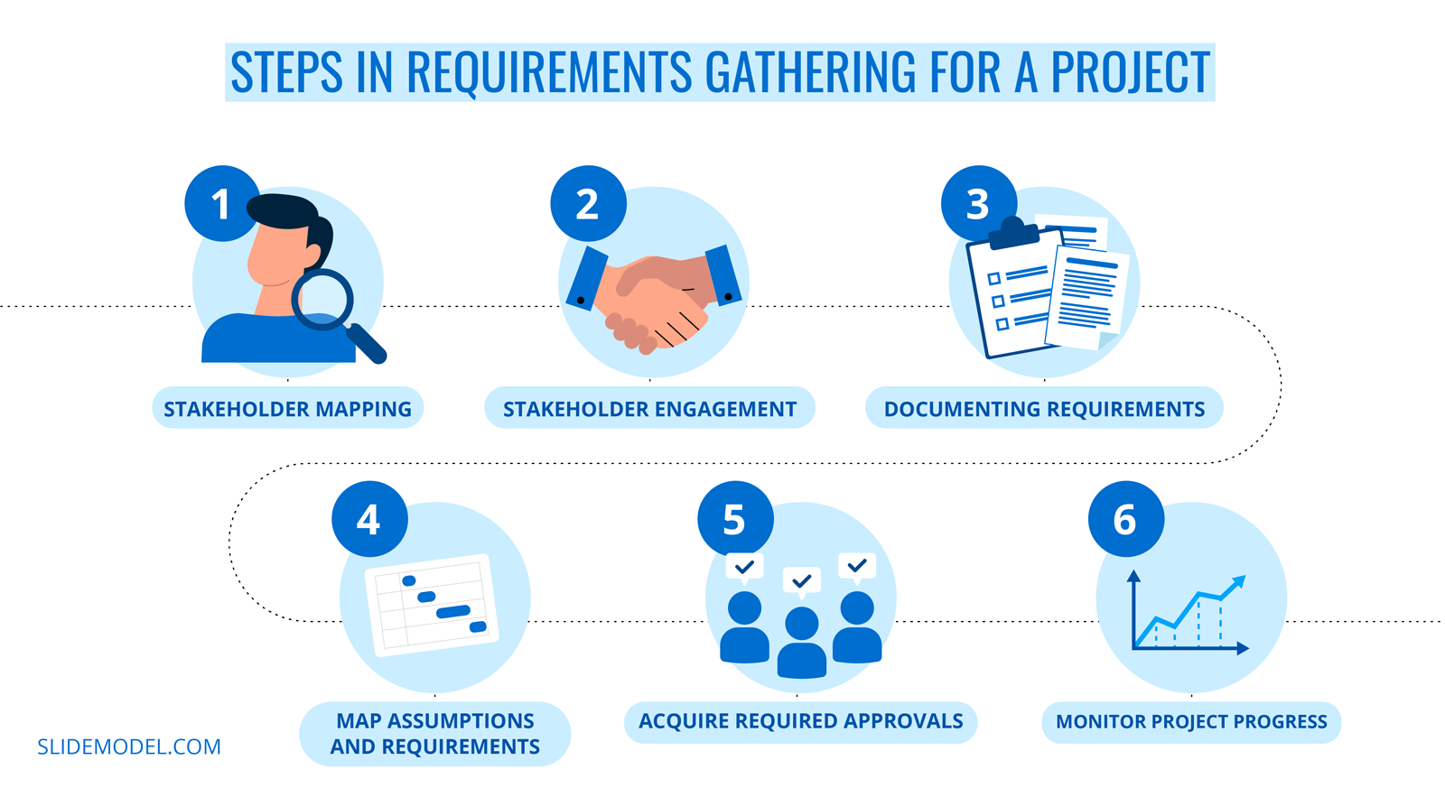
Requirement gathering process

Slide 6
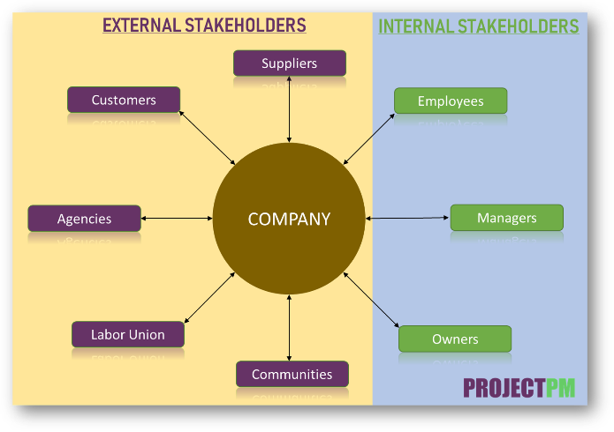
Stakeholder Analysis.
Stakeholder: End Users, Administrator, Technical Team, Sponsor and supervisor ,
Roles and Responsibilities
Interests:
Requirements, Expectations, and Concerns

Slide 7
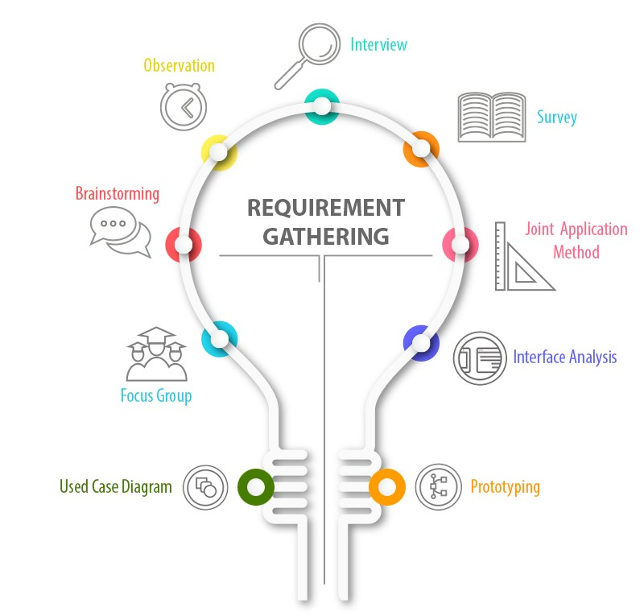
Requirement Gathering methods
Brainstorming(developers)
Interview(in-person)
Survey(google forms)
Prototyping(wireframes)

Slide 8

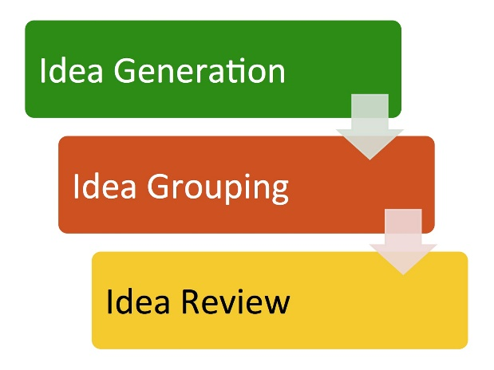

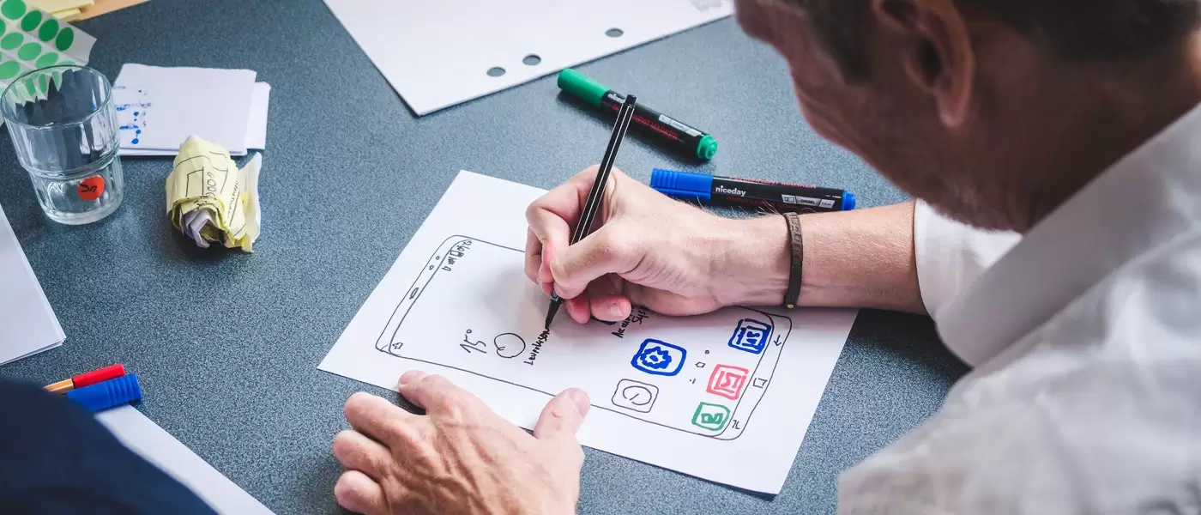

Requirement Gathering methods
Brainstorming
Survey
Prototyping
Interviews

Slide 9
Requirement Gathering Per stake holder
Stakeholder: End Users, Administrator, Technical Team, Sponsor and supervisor ,
Methods used
Questions ask
Sample response(Adolescent, adult)
Persona

Slide 10
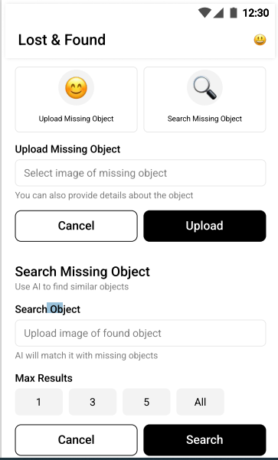
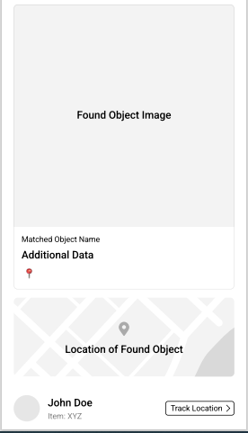
User home page

Slide 11
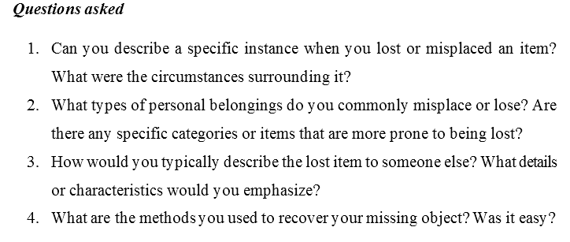
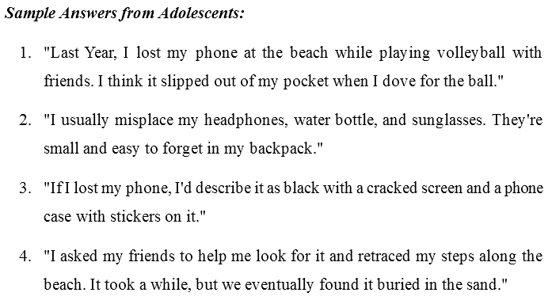
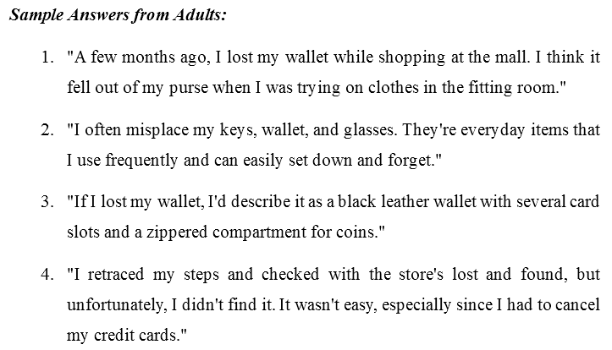
Requirement Gathering Per stake holder Sample questions and answers

Slide 12
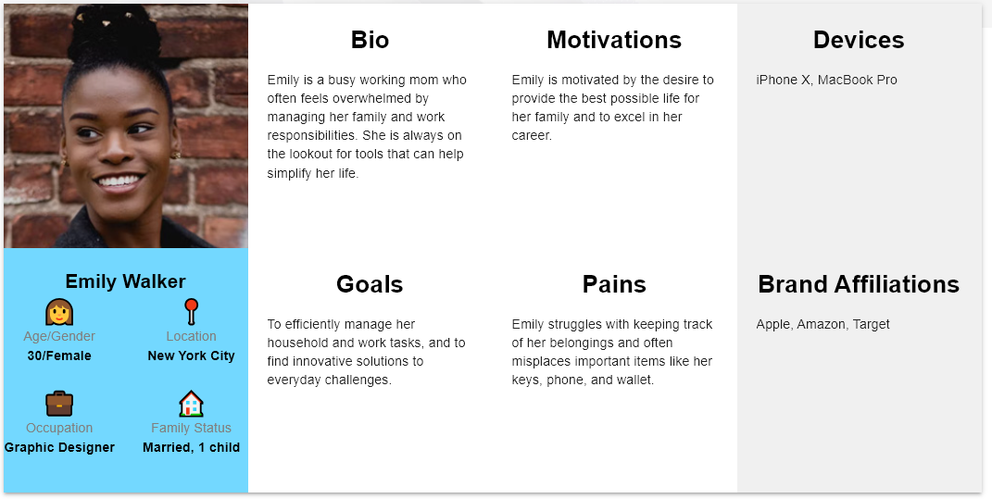
Persona(user representative)

Slide 13
Requirement Documentation s
Documentation
Functional
non-functional

Slide 14
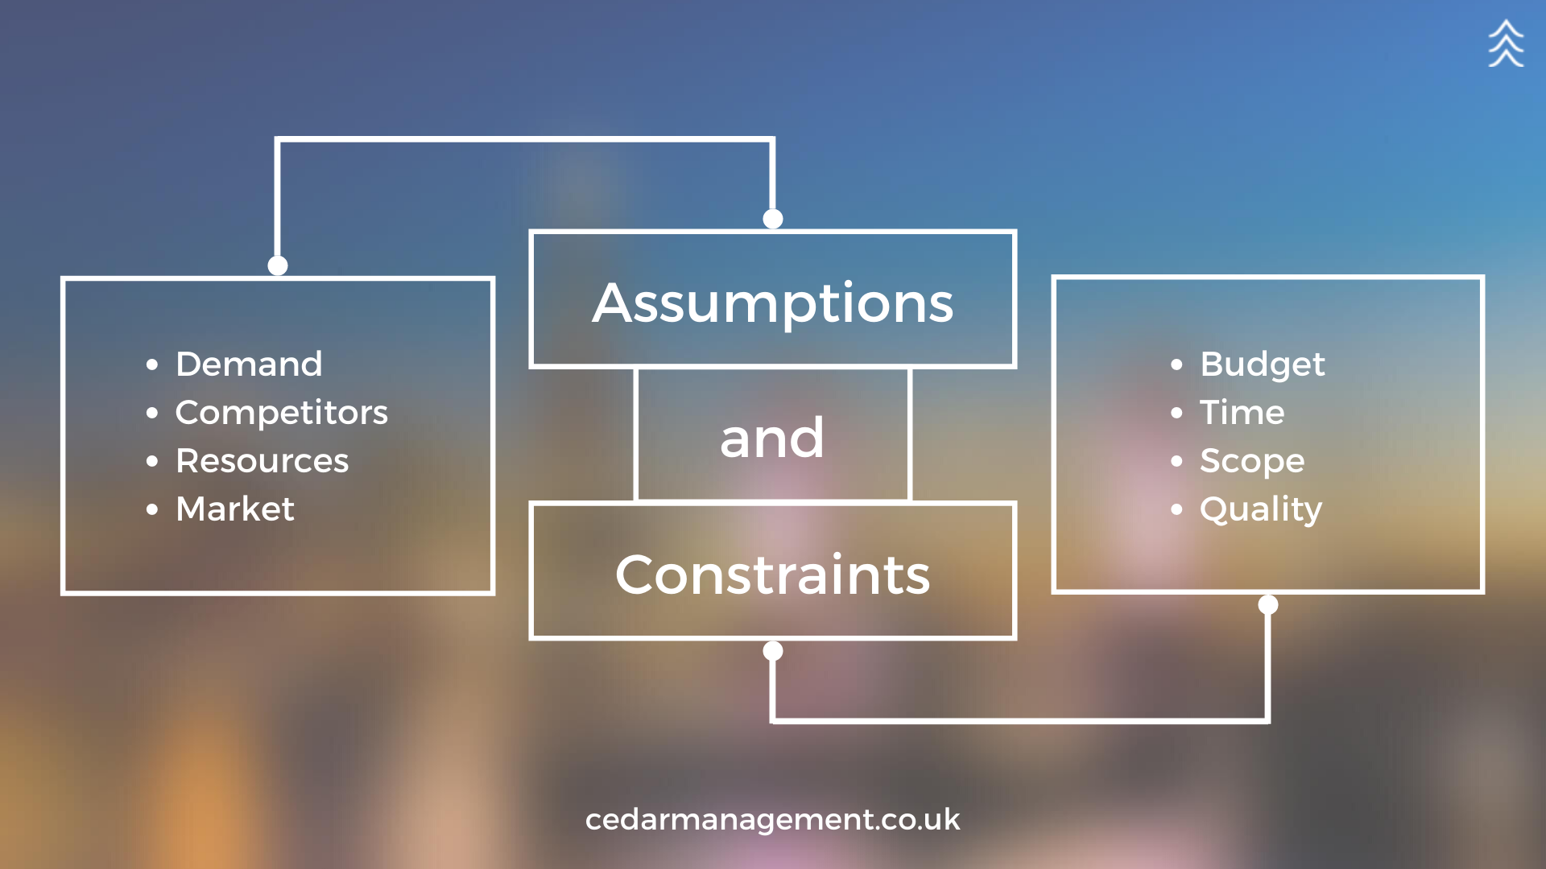
ASSUMPTIONS AND CONSTRAINTS
Assumptions
Users have smartphones
Potential impact
Low quality(picture quality)
Users have stable internet Connection
Potential impact
Slow internet connectivity(slow image upload)

Slide 15
ASSUMPTIONS AND CONSTRAINTS
Constraints:
Budget Constraints
Impact
Time constraint
Impact
Technical limitations
impact

Slide 16
Conclusion
Recap of the presentation

Slide 17
Thanks for your kind attention group 6

